Slide 1
Human-Computer Interaction & Design Principles

Slide 2
HCI has always been a part of technology and design, but it is on the rise as technology becomes more integrated with our daily lives. HCI is a vital skill for any developer, product manager, or designer who wants to design for the future.

Slide 3
HCI helps to make interfaces that increase productivity, enhance user experience, and reduce risks in safety-critical systems. Poorly designed machines lead to many unexpected problems, sometimes just user frustration, but sometimes, chaotic disasters.
This is why HCI is on the rise. As we become more dependent on technologies, even just the Internet or smartphones, HCI has become a key part of designing tools that can be used efficiently and safely on a daily basis.

Slide 4
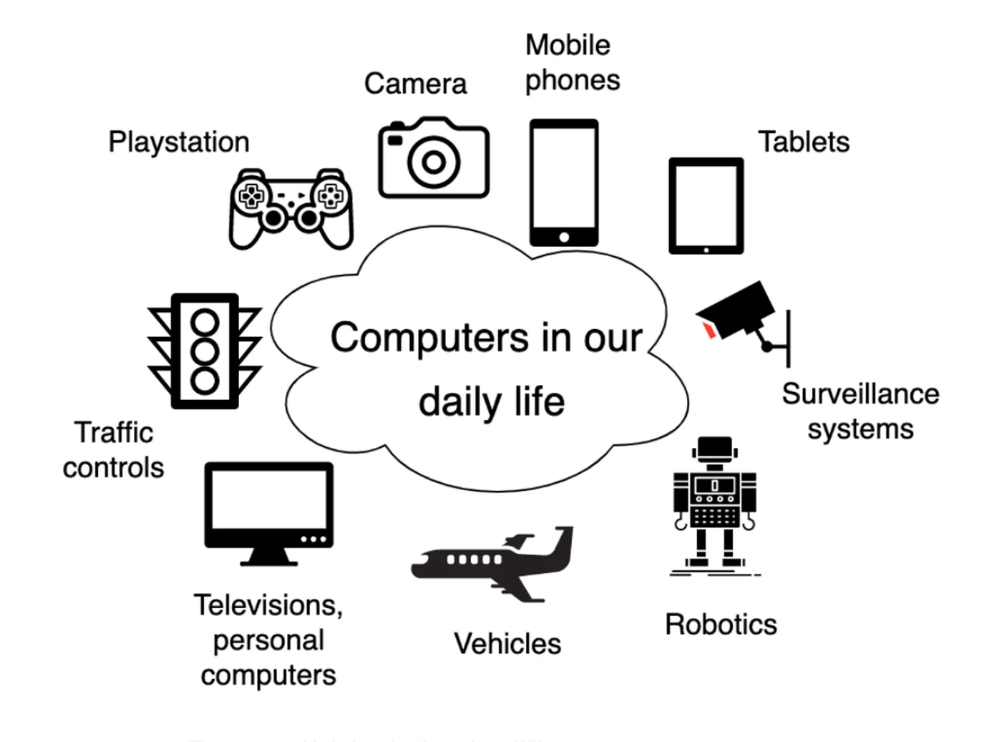

Slide 5
Research applications in this field focus on:
How to design improved computer interfaces that are optimized for particular qualities, such as learnability, findability, and usability.
How to evaluate and compare different interfaces in terms of their usability
How to determine if a user is human or computer
How to study the sociocultural implications of human-computer interactions

Slide 6
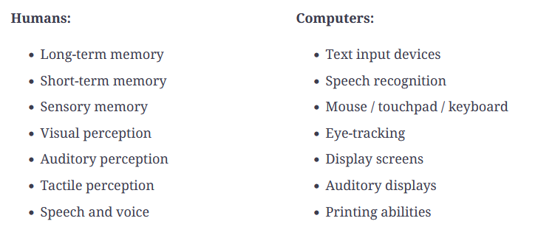
In order to build effective interfaces, we need to first understand the limitations and capabilities of both components. Humans and computers have different input-output channels.

Slide 7
Norman’s model of interaction
Norman’s model of interaction (sometimes called the execution-evaluation cycle) a notable model for HCI. It proposes that a user first establishes a goal and then performs actions using the system to achieve that goal.
A system then reflects the output of those actions on the interface. A user observes the interface and evaluates if their goal has been met. If not, a new goal is established, and the cycle is repeated.

Slide 8
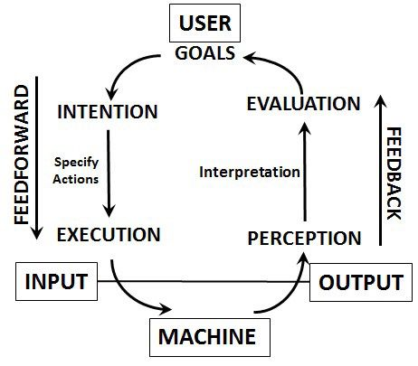

Slide 9
Execution: There is a difference between user actions and those that the system can perform. An effective interface allows a user to perform an action without system limitations.
Evaluation: There is a difference between the presentation of an output and the user’s expectations. An effective interface can be easily evaluated by a user.
Human error: The system is performing correctly, but the user has inputted an error. Errors can be avoided by improving interface design or providing better user support.

Slide 10
Ergonomics of Interaction
Another key component of HCI is ergonomics. Once we understand how a computer and user interact via an interface, we need to better understand how to enhance user performance. There are many ergonomical factors that come into play when designing a system:
Controls and display: Display sections and controls should be grouped logically according to human perception. The logic of arrangement depends on the application and the domain, such as by sequence, function, or frequency.
Colors: Since humans are limited by visual perception, it’s key to design color properly. Colors should always be distinct, and the distinction of colors should remain unaffected by changing contrast. Common color conventions should also be used (for example, red for a warning and green for success).

Slide 11
Design Process Steps :
There are three general steps to follow for interaction design. Let’s examine each in detail.

Slide 12
User research and requirements analysis
Before designing, we must know about our users and what problems they have that we can solve with our system. Any technology we want to build will have a specific context that should guide the design process.
For example, will the interface be used in a safety-critical system?

Slide 13
2. Designs and prototyping
The second step involves creating the designs and prototyping. We are essentially converting our requirements into possible solutions. This will include both conceptual design (how will a system perform) and physical design (colors, interaction styles). Then we prototype our different design ideas.

Slide 14
3. Evaluating the designs
Once the final product has been built, we must evaluate this design. Both experts and actual users should be evaluators to test that it meets requirements and HCI design principles. From there, we can tweak and design and make improvement alterations.

Slide 15
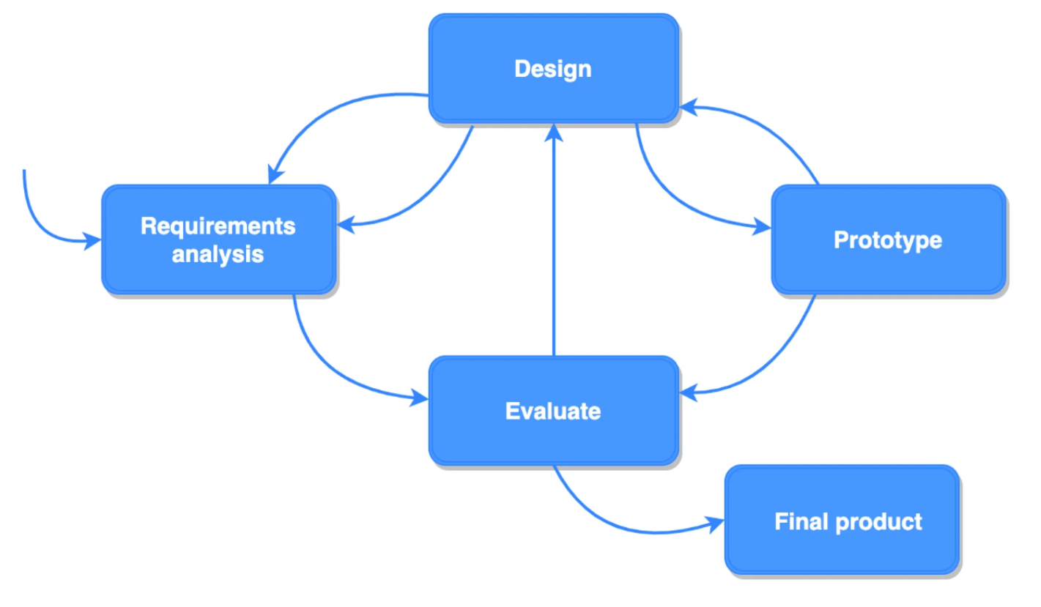

Slide 16
HCI Design Rules and Best Practices
There are many best practices and rules that have been established by HCI researchers and designers. These rules include abstract design principles, to common-place standards, and design guidelines.

Slide 17
Design for learnability and familiarity
Learnability and familiarity principles determine how easily a novice user can learn to interact with a system. To achieve this, a system should be predictable. Any user should be able to predict the results of future actions based on the knowledge of their interaction history.
Similarly, a user should be able to map experiences with other computing systems to a new system. Familiarity determines whether a user can initiate interaction. Metaphors (usually visual) are a common way that systems achieve this principle. For example, a trash bin icon should represent the action to delete items, as it is familiar and predictable.

Slide 18
Make elements legible and accessible
All characters and objects must be perceptible in order to be used effectively. Multiple modes of “legibility” should be used to represent information (visual, verbal, and haptic). Similarly, a system must equally useful to users with diverse abilities. For example, users with visual impairment should be provided with equivalent support systems.

Slide 19
Tolerance for error
Users will make errors, but they should not change the system state or impact an interaction disastrously. Warnings should be provided to prevent potential mistakes, and a system should not have a critical situation that can be reached easily by the user. A system must also offer assistance when potential errors arise.

Slide 20
Flexibility
Any design should provide multiple ways to perform a given task. This allows the user to interact with a device according to their ability or preference. Users need options to choose methods that best fit their pace and experience. Systems that are flexible are more useful for a wide range of users.

Slide 21
Don’t reinvent the wheel
It’s important to innovate but not at the expense of learnability and accessibility. Users have developed old habits from other interfaces that will transfer to well-designed systems. A design that uses ready-made standards will be a more intuitive, useful product.

